Slide 1




Data Analytics
Industrial Summer Training

Slide 2
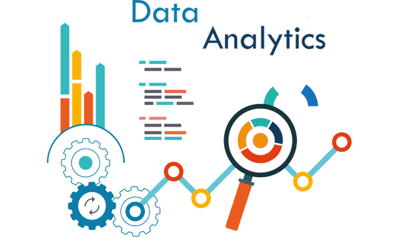
In today’s world data is everything. It is everywhere and in big quantities, but the big question is how to get usefull information from this data? This is where data analysis comes. It extracts, transforms and load data in most usefull and easy to understand way.

Slide 3


Importance of data analytics:
Better Customer Targeting
You Will Know Your Target Customers Better
Reduce Operational Costs
Better Problem-Solving Methods
You Get More Accurate Data
Notes:
Once you find your sources, you will want to evaluate your sources using the following questions:
Author:
Who is the author?
Why should I believe what he or she has to say on the topic?
Is the author seen as an expert on the topic? How do you know?
Current:
How current is the information in the source?
When was the source published?
Is the information out-of-date?
Accuracy:
Is the content accurate?
Is the information presented objectively? Do they share the pros and cons?

Slide 4

Problems:
ONE-OFF REPORTING IS TIME CONSUMING
FINDING SPECIFIC DATA IN LARGE DATA VOLUMES
DATA QUALITY
LACK OF SECURITY
ONLY TECH TEAMS CAN CREATE BUSINESS REPORTS
Notes:
When conducting research, it is easy to go to one source: Wikipedia. However, you need to include a variety of sources in your research. Consider the following sources:
Who can I interview to get more information on the topic?
Is the topic current and will it be relevant to my audience?
What articles, blogs, and magazines may have something related to my topic?
Is there a YouTube video on the topic? If so, what is it about?
What images can I find related to the topic?

Slide 5
Solution :
Power BI helps you to access your data instantly with less manual work. It can handle a huge amount of data making it easy to decipher using advanced visualizations. It allows you to get data from different data sources by automatically connecting with them, saving you time and effort.
Power BI helps you quickly identify data quality issues and provides numerous ways to address them. Power Query provides you with exciting features to clean and prepare data for analysis.
Power BI overcomes these issues by leveraging Azure Active Directory for authentication and Power BI login credentials to access the resources.
On the other hand, Microsoft Power BI is a user-friendly and simple tool and can be used by anyone, even by non-experienced BI people.
Notes:
When conducting research, it is easy to go to one source: Wikipedia. However, you need to include a variety of sources in your research. Consider the following sources:
Who can I interview to get more information on the topic?
Is the topic current and will it be relevant to my audience?
What articles, blogs, and magazines may have something related to my topic?
Is there a YouTube video on the topic? If so, what is it about?
What images can I find related to the topic?

Slide 6
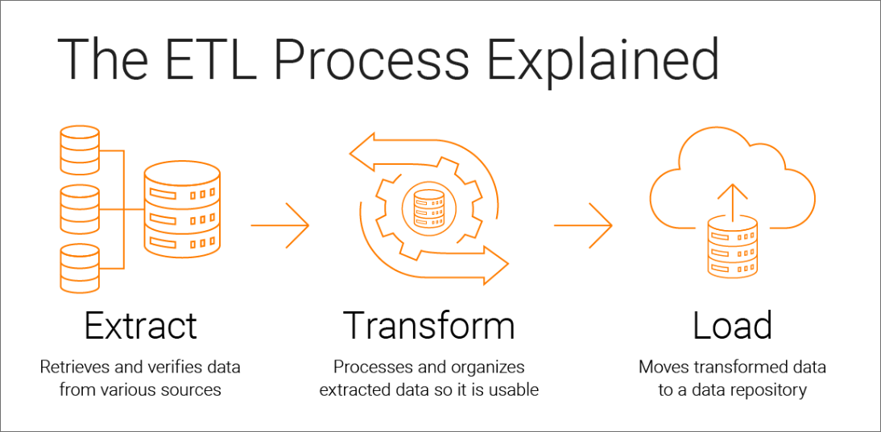
ETL :
the data from its original source, whether that is another database or an application
data by cleaning it up, deduplicating it, combining it, and otherwise getting ready to…
the data into the target database
Notes:
When conducting research, it is easy to go to one source: Wikipedia. However, you need to include a variety of sources in your research. Consider the following sources:
Who can I interview to get more information on the topic?
Is the topic current and will it be relevant to my audience?
What articles, blogs, and magazines may have something related to my topic?
Is there a YouTube video on the topic? If so, what is it about?
What images can I find related to the topic?

Slide 7
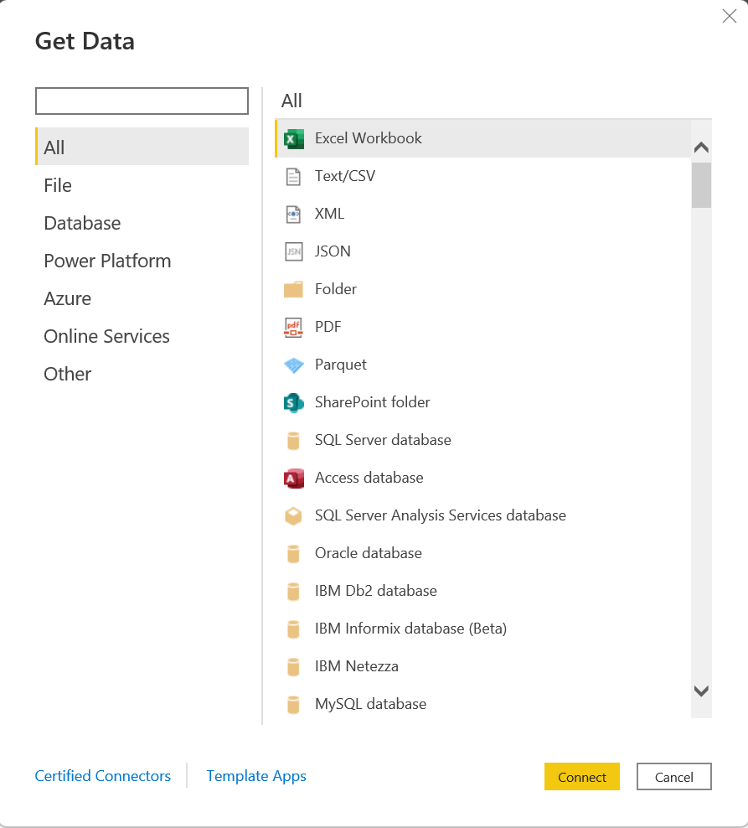
Notes:
When conducting research, it is easy to go to one source: Wikipedia. However, you need to include a variety of sources in your research. Consider the following sources:
Who can I interview to get more information on the topic?
Is the topic current and will it be relevant to my audience?
What articles, blogs, and magazines may have something related to my topic?
Is there a YouTube video on the topic? If so, what is it about?
What images can I find related to the topic?

Slide 8
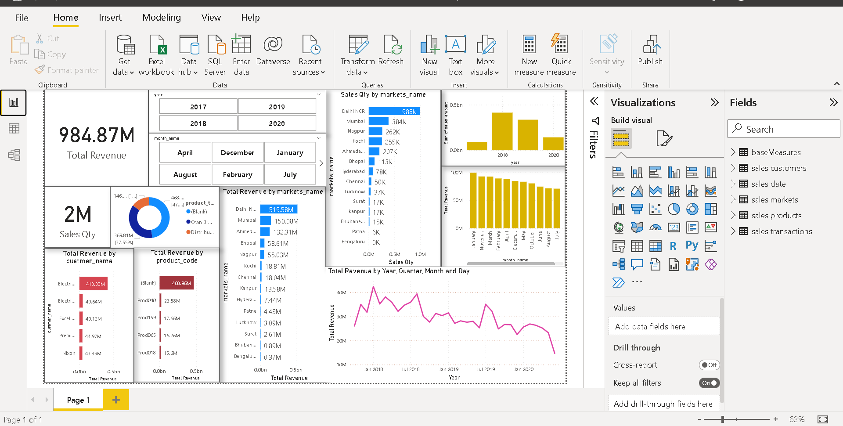
data by cleaning it up, deduplicating it, combining it, and otherwise getting ready to…
Notes:
When conducting research, it is easy to go to one source: Wikipedia. However, you need to include a variety of sources in your research. Consider the following sources:
Who can I interview to get more information on the topic?
Is the topic current and will it be relevant to my audience?
What articles, blogs, and magazines may have something related to my topic?
Is there a YouTube video on the topic? If so, what is it about?
What images can I find related to the topic?

Slide 9
Load in Power Query
Here, the transformed data is loaded into a data warehouse or an analytic tool in the case of Power BI and Excel.
Note:
Power BI provides number of plugins and other 3rd party feature to do this whole ETL process convenient and fast
Notes:
When conducting research, it is easy to go to one source: Wikipedia. However, you need to include a variety of sources in your research. Consider the following sources:
Who can I interview to get more information on the topic?
Is the topic current and will it be relevant to my audience?
What articles, blogs, and magazines may have something related to my topic?
Is there a YouTube video on the topic? If so, what is it about?
What images can I find related to the topic?

Slide 10

Technology Stack
Sql: This is used to match the results of our query and Mysql server is used to extract data to Power BI for analysis.
Power BI: this is the main app we use to analyse our data. It can be divided into three sections:
DAX: Data Analysis Expression, Power BI uses its own language for creating calculated columns and measures used for cleaning and visulizaton.
Notes:
After consulting a variety of sources, you will need to narrow your topic. For example, the topic of internet safety is huge, but you could narrow that topic to include internet safety in regards to social media apps that teenagers are using heavily. A topic like that is more specific and will be relevant to your peers. Some questions to think about to help you narrow your topic:
What topics of the research interest me the most?
What topics of the research will interest my audience the most?
What topics will the audience find more engaging? Shocking? Inspiring?

Slide 11

SQL
Basic Commands like: Select, From, In , Where , And , Or so on.
Aggregate Functions: Count, Sum, Min ,Max ,Average .
Joins And Unions: Left Join, Full Join , Right Join, Union , Union All etc.
Notes:
After consulting a variety of sources, you will need to narrow your topic. For example, the topic of internet safety is huge, but you could narrow that topic to include internet safety in regards to social media apps that teenagers are using heavily. A topic like that is more specific and will be relevant to your peers. Some questions to think about to help you narrow your topic:
What topics of the research interest me the most?
What topics of the research will interest my audience the most?
What topics will the audience find more engaging? Shocking? Inspiring?

Slide 12

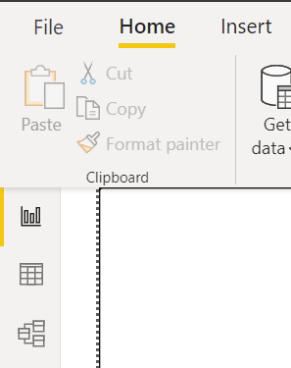

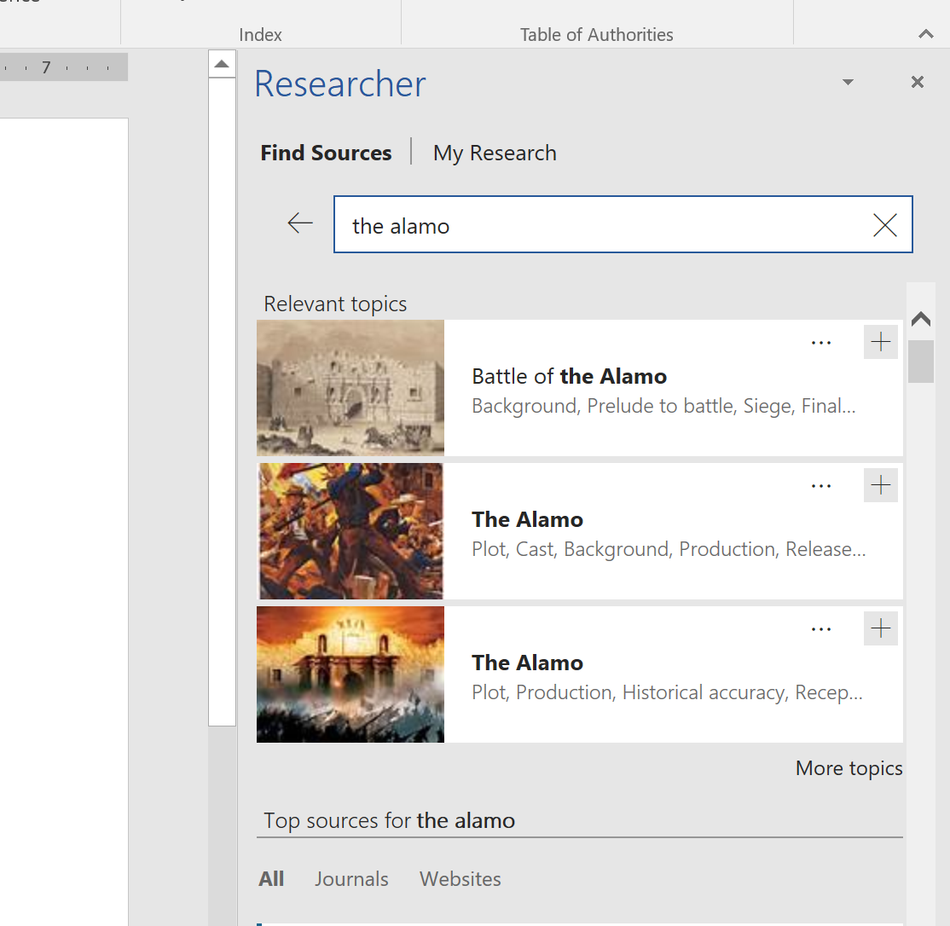

Power BI:
1
2
1. Power BI consist of three Views :
Report View
Data View
Model View
2. These three components are where magic happens, from raw data to a great clean visualization is done.

Slide 13
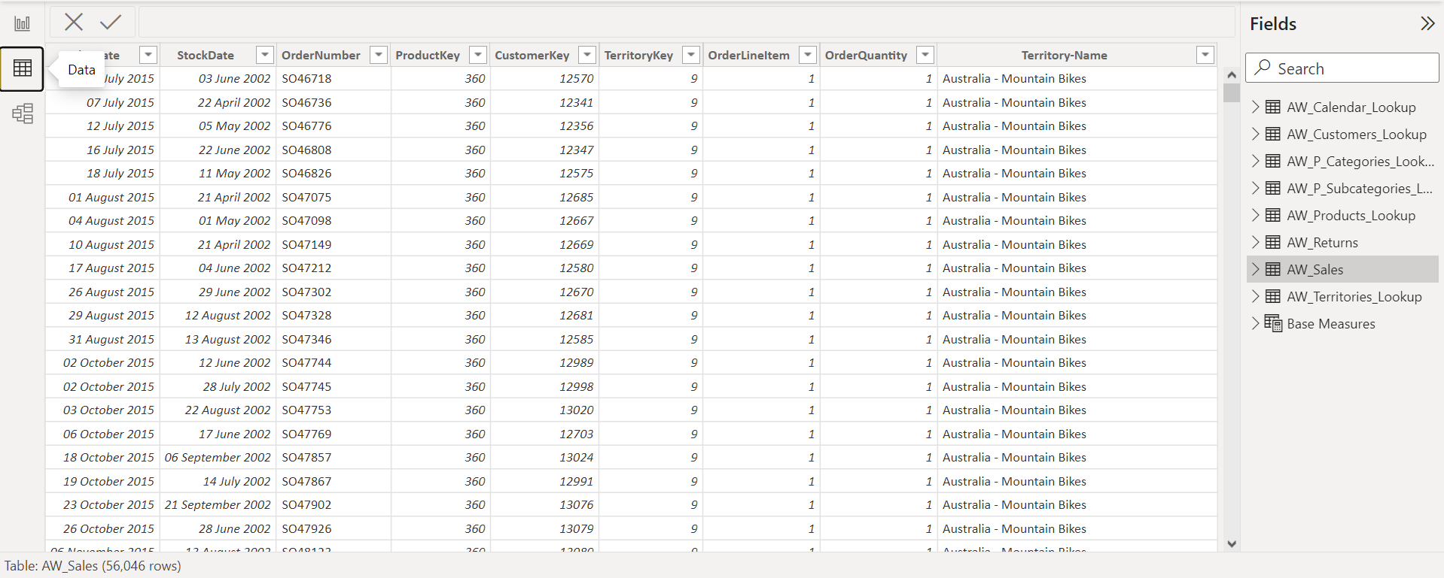
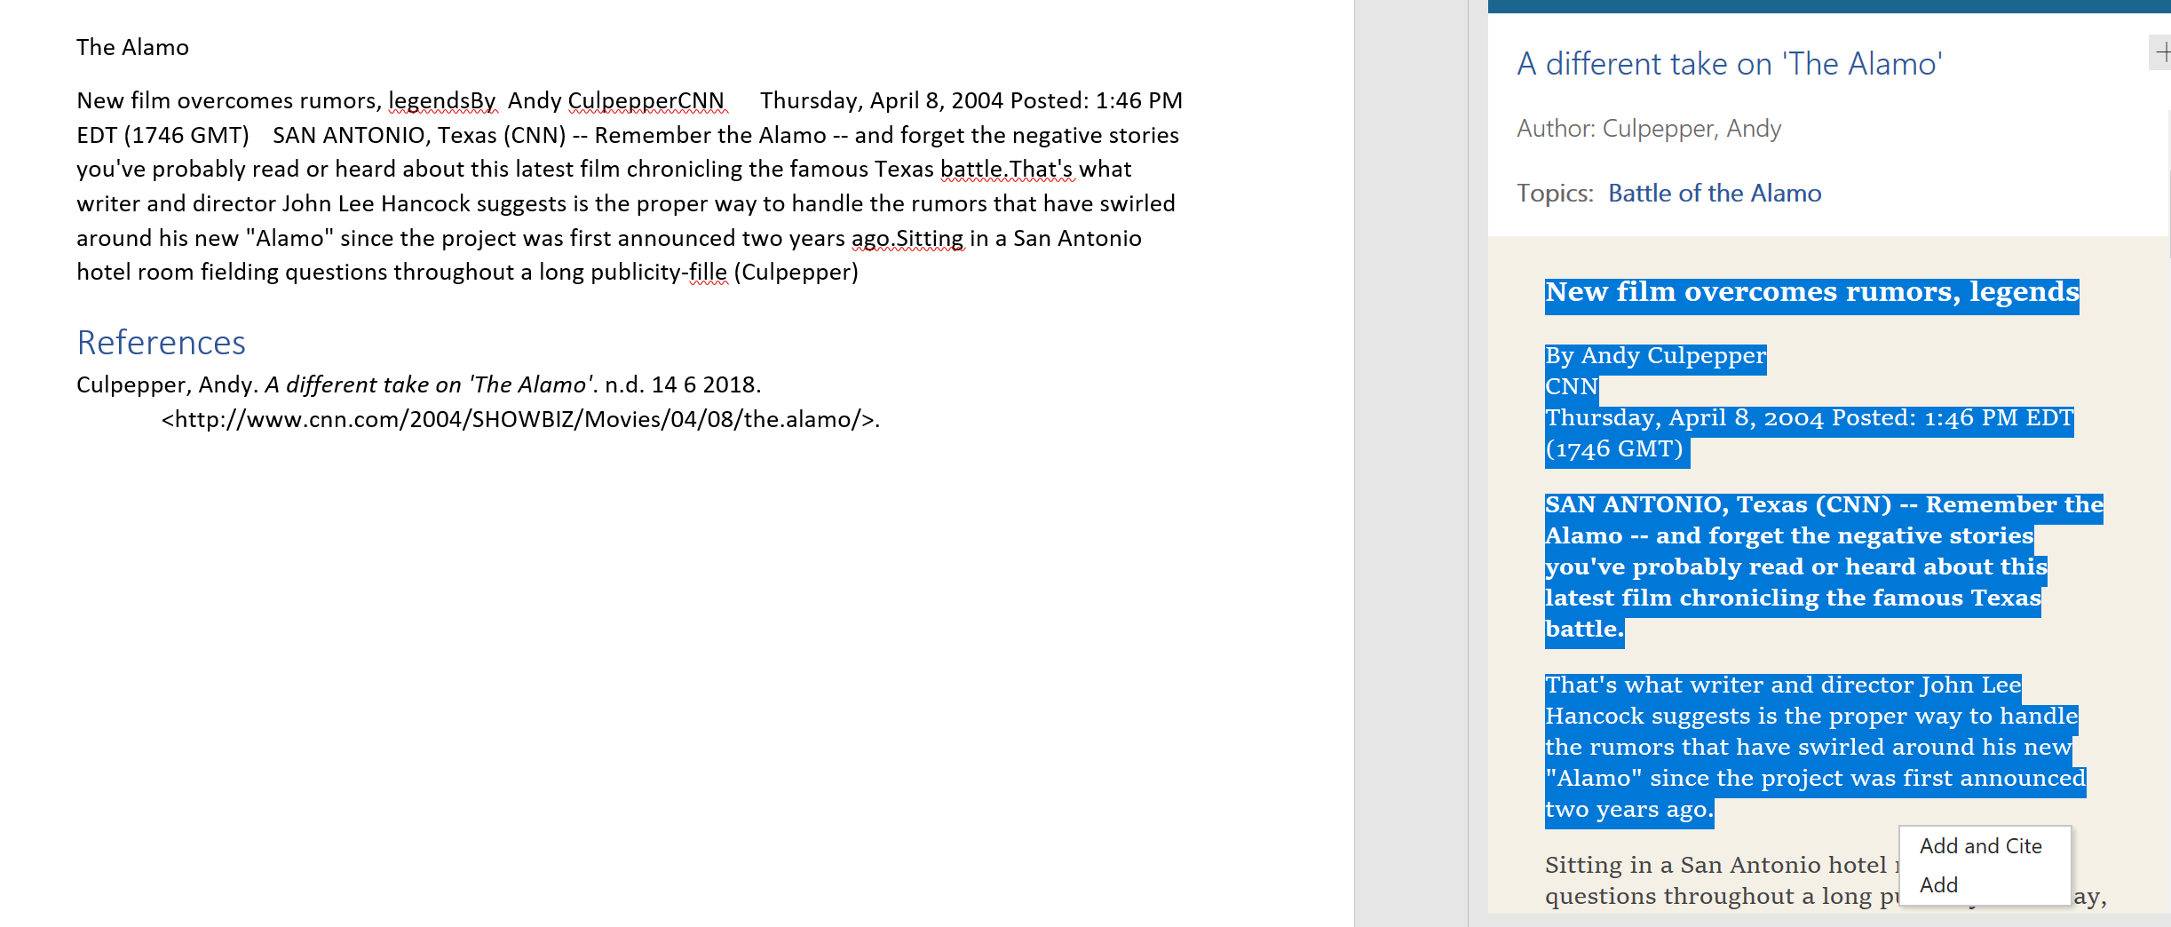
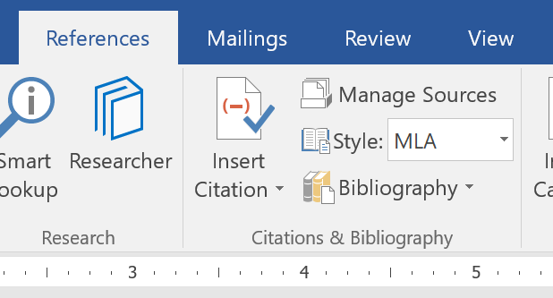
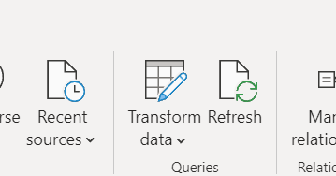
3
Data View: In this view we change all data according to our need, clear errored data, add new columns, change data types and anything we want with to change with tables.
4. Power Query: We use this to perform operations on data more efficiently.
4

Slide 14
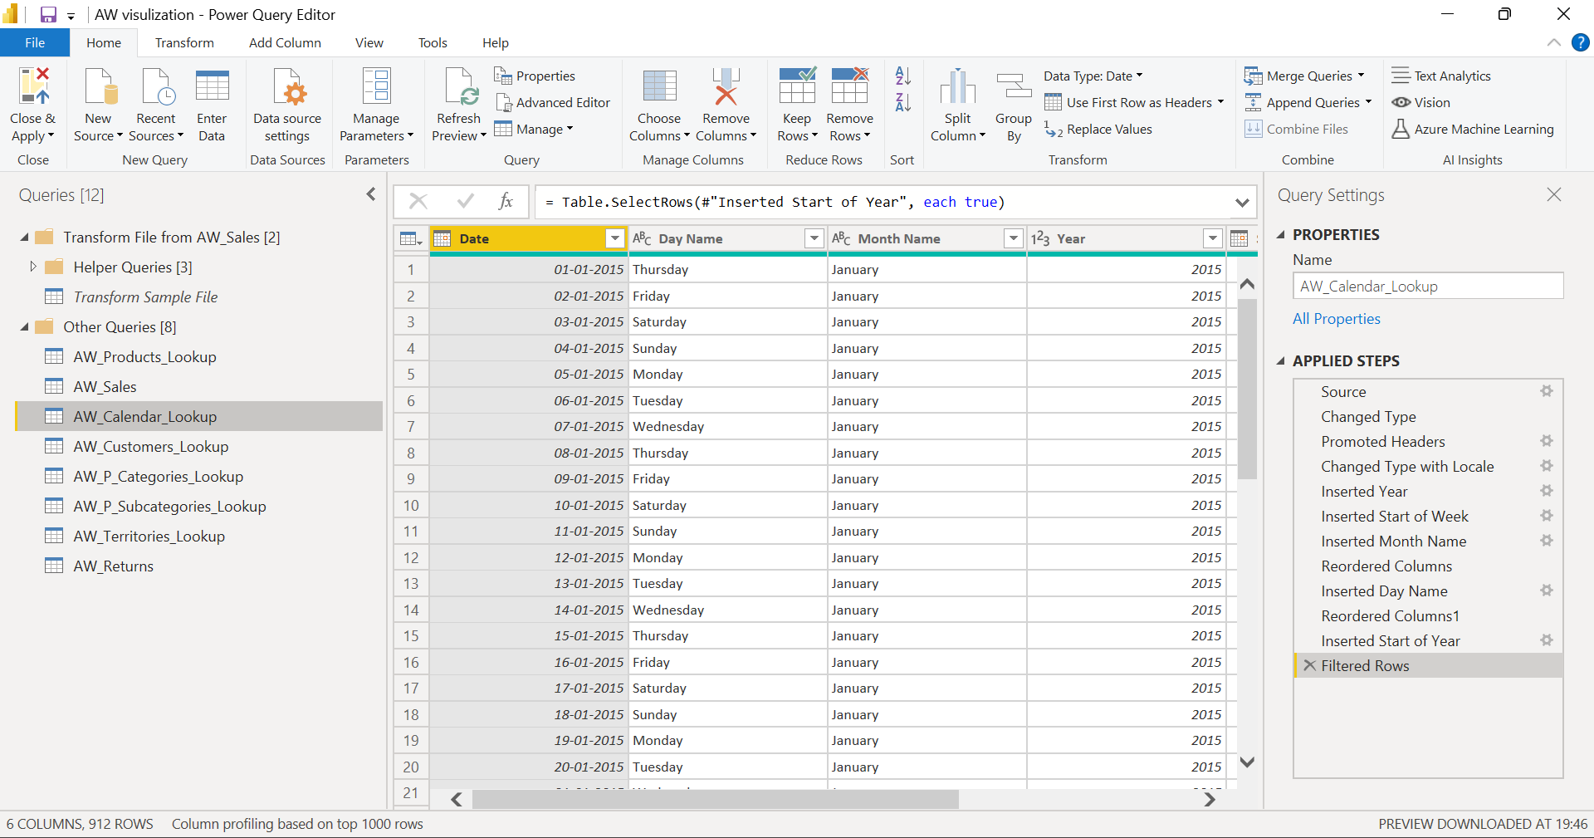
5
5. Power Query is Microsoft’s Data Connectivity and Data Preparation technology. It basically, enables business users to access data stored in data sources seamlessly whilst, reshaping it to fit their needs. It’s easy to use, engaging, even convenient to use for the no-code users.

Slide 15
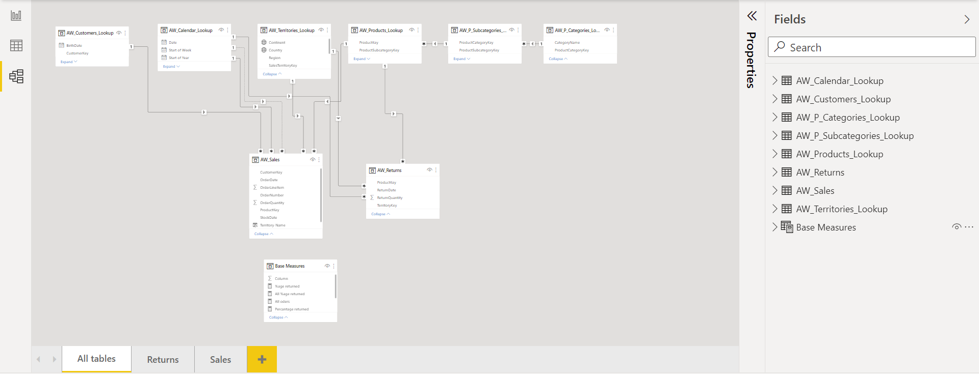
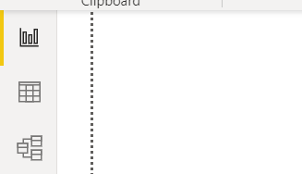
7
6. Model view: Once we have data structured according to our needs we can create relationships and hierarchy between data.
One to one
One to many and so on.
6

Slide 16
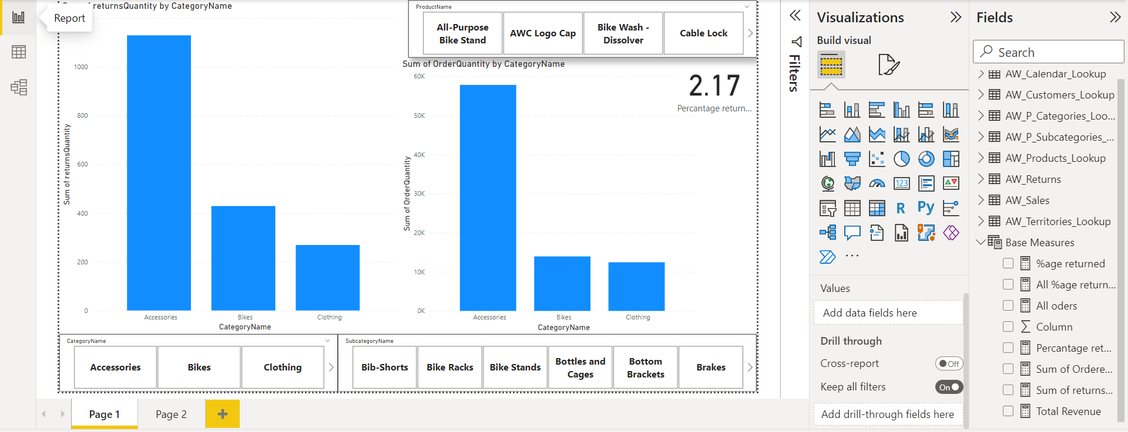
9
6. Model view: Once we have data structured according to our needs we can create relationships and hierarchy between data.
One to one
One to many and so on.
8

Slide 17

DAX
Data Analysis Expression
DAX: It uses its own language for creating calculated columns and measures used for cleaning and visualisation.
Calculated columns : When you create a data model in Power Pivot for Excel, Analysis Services Tabular, or Power BI Desktop, you can extend a table by creating new columns. The content of the columns is defined by a DAX expression evaluated row by row. The user interface is different depending on the tools you use.
Measures: There is another way of defining calculations in a DAX model, useful whenever you do not want to compute values for each row but, rather, you want to aggregate values from many rows in a table. These calculations are measures
Notes:
After consulting a variety of sources, you will need to narrow your topic. For example, the topic of internet safety is huge, but you could narrow that topic to include internet safety in regards to social media apps that teenagers are using heavily. A topic like that is more specific and will be relevant to your peers. Some questions to think about to help you narrow your topic:
What topics of the research interest me the most?
What topics of the research will interest my audience the most?
What topics will the audience find more engaging? Shocking? Inspiring?

Slide 18
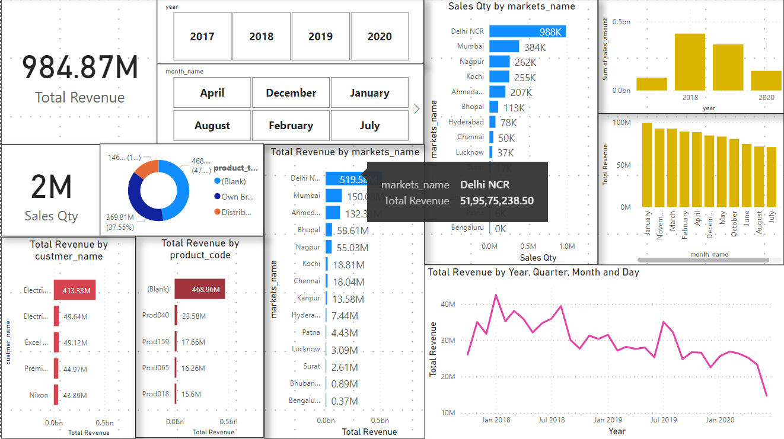
This Is desktop view of visualisation.
We uses various tools , measures created from DAX, model relations to plot different graphs and tables.

Slide 19
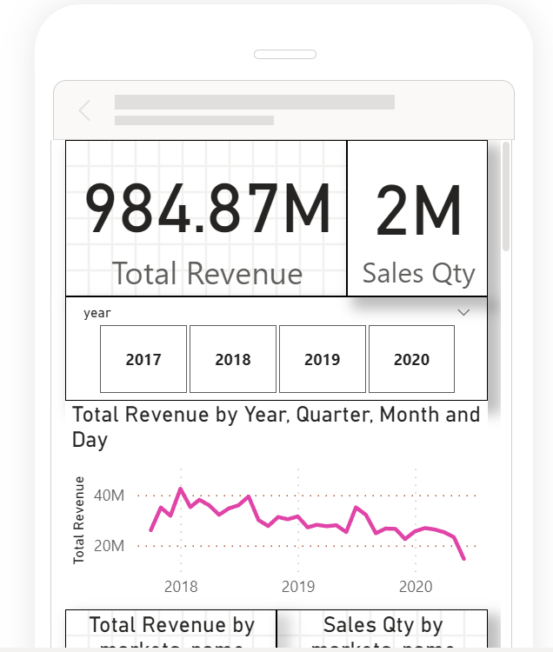
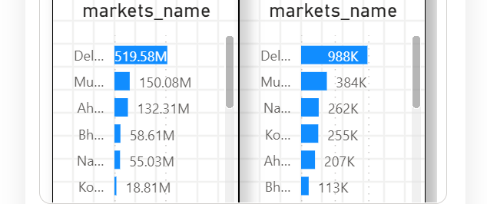
This Is mobile view of same desktop visualisation.
Power BI allows us to create different mobile view for mobile usage and even give us link to share.

Slide 20
Conclusion
Power BI is a tool with impressive analytical capabilities and immersive visual dashboards. It helps companies make data-driven decisions and facilitate easy implementation without requiring significant upfront expenses. The benefits of Power BI discussed above are good reasons for companies to consider investing in it and to improve their tactical strategic management processes.
Notes:
After you’ve done your research, it’s time to put your presentation together. The first step in the process is to introduce the topic. This is a great time to connect your topic to something that your audience can relate. In other words, why should they listen to all the information you will be sharing in your research presentation? What is in it for them? You may also want to include a graphic or image to grab their attention.
Feel free to duplicate this slide by right-clicking on this slide in the slides pane to the left and select Duplicate Slide.
The next step in your presentation is to state your claim or topic clearly. Your teacher may even call this your thesis. As you state your thesis, you may find that this layout is not the best layout for your claim or topic. You can change the layout by clicking the drop-down menu next to the Layout in the Slides menu section. You can choose Two Content, Comparison, or Picture with Caption. Note: A different layout might change the look of the icons on this page.
You will also want to state your facts. You have done the research now share some of the interesting facts with your audience. Facts do not have to be boring; you can communicate facts in a variety of ways by going to the Insert Tab. In the Insert tab you can:
Insert pictures from your computer or online.
Add a chart
Create some SmartArt
Insert a variety of icons to help your facts come to life. Note: You can change the color of the icons by selecting the icon and then click on the Format tab and then Graphics Fill. From there, you will choose a color from the list or choose More Fill Colors to give you more options.
Since this research presentation is a result of your hard work and searching, you want to make sure you support the claims or points in your presentation with facts from your research findings. Make sure you give the author proper credit for helping you share your ideas. If one of your sources has a video that is relevant to your topic, you can add the video as added support. Keep in mind the length of the video and the amount of time you have for your presentation. For a 5 minute speech, the video should be no longer than 30 seconds.
Questions to consider:
How will you state the author of the source?
Will you need to cite the source on the slide?
What are some ways you can engage your audience so they feel like they are a part of the presentation? Some ideas to consider is by taking a quick poll like: by a show of hands, how many of you think school uniforms are a way to cut down on bullying? Another suggestion is to have them hold up a certain number of fingers to see if they agree or disagree. Finally, you can share a story that the audience can relate to that makes them laugh.
After all the applause, your audience may have some questions. Be prepared to answer some of their questions by making a list of questions you think they might ask. You may also want to share the presentation with them by providing the link to your presentation, if they want more information.

Slide 21

Crest Bell
Power BI course provided by company Crest Bell, located in sector 37 Chandigarh.
Notes:
Now, that you have narrowed your topic, you will want to organize your research in a structure that works. There are some common organizational patterns based on the kind of research you are doing.
Organizational Structures:
Cause and Effect- this kind of structure is great for explaining the causes and effects of a topic
Compare and Contrast- in this pattern you highlight the similarities and differences of the topic
Explain process- this structure is great for outlining a series of steps to follow;
Definition- if you want to make sure your audience understands what something is using illustrations, meanings, clarifying misconceptions, you may want to use this structure
Classification- a common organizational structure is grouping like topics or facts from the research together. For instance, in the internet safety about social media apps, you may organize the research where you look at each social media app one at a time

Slide 22

Thank You

